Slide 1

Marketing Planning
Chapter 2 The Marketing Plan
Section 2.1 Marketing Planning
Section 2.2 Market Segmentation

Slide 2
Lesson 2.2
Market Planning

Slide 3

Marketing Planning
Key Terms
SWOT analysis
environmental scan
marketing plan
executive summary
situation analysis
marketing strategy
sales forecasts
performance standard
Objectives
What is a Marketing Plan
Conduct a SWOT analysis
List the three key areas of an internal company analysis
Identify the factors in an environmental scan
Marketing Essentials Chapter 2, Section 2.1

Slide 4
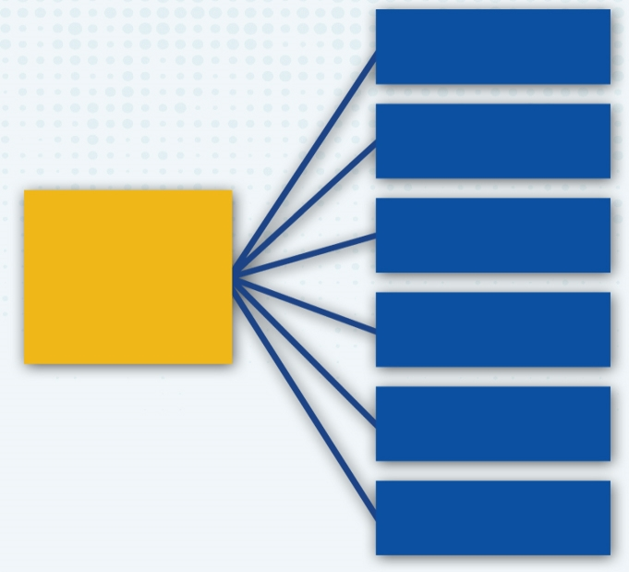
Six Elements of a Marketing Plan
Executive Summary
Written last – defines the entire plans key points
Situation Analysis
Your SWOT
Elements of a Marketing Plan
Single goal of what going to do as a company.
Objectives
Marketing Strategies
4ps: Product, Place, Price, Promotion
Implementation
When, how, and who will implement plan, budget
Evaluation and Control
Measurement on how you are doing

Slide 5
Marketing Planning
Situational analysis - An assessment of a company’s current strengths and weaknesses and the opportunities and threats that surround it;
AKA SWOT
Strengths
Weaknesses
Opportunities
Threats

Slide 6
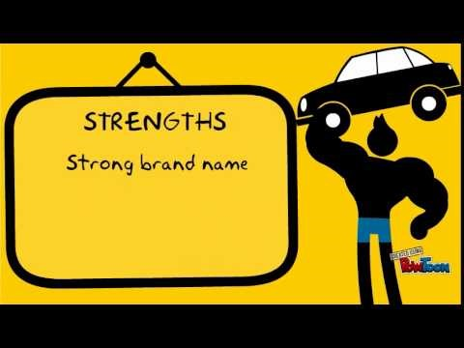
Video Link

Slide 7




The SWOT Definitions
Strengths: Internal positive characteristics of what a business does well or better than competitors – Positive Factors in a company’s control
Competitive Advantage: is the attribute that allows an organization to outperform its competitor
Weaknesses: Internal characteristics of a company that they don’t do well in comparison to competitors. (competitive disadvantages) – Negative factors in a company’s control
Opportunities: External untapped markets or business developments/trends they could add/use to make their business better - Positive factors outside company’s control
Threats: Elements of the external environment that could negatively affect the company - Negative factors outside company’s control

Slide 8
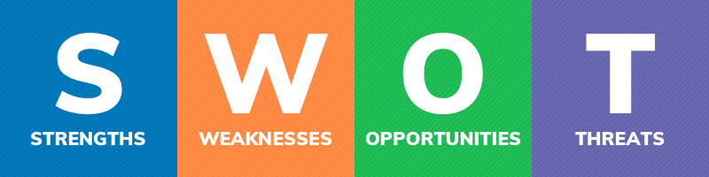
Things your company does well | Things your company lacks | External Trends that could increase your sales | External Trends that could result in business loss
Qualities that separate you from competitors | Things you competitors do better than you | Underserved markets for specific products | emerging competitors,
Internal resources such as skilled knowledgeable staff | Resource Limitations | Few competitors in your area | Laws and regulations that change your business
Tangible assets such as intellectual property, capital, proprietary technologies | Unclear unique selling proposition | Emerging need for your products or services | Changes in consumer attitudes, technology, or negative press
External Factors that could result in business loss
External Trends that could increase your sales

Slide 9
SWOT Analysis
Two Internal Factors
What two components analyze internal factors that impact a business?
Strengths and Weaknesses
Two External Factors
What two components analyze external factors that impact a business?
Opportunities & Threats

Slide 10
SWOT
Everyone take 4 yellow sticky notes
Do not enter your name on them (anonymous)
Think about yourself – what are 2 things that you do really well
Think about yourself – what are 2 things that you think you don’t do as well as others
On the wall chart – place your sticky notes under the S & W

Slide 11

Internal Analysis looks at the Three Cs
The three C’s of internal analysis
What do you think the three “C”s are?
C
ompany
C
ustomers
C
ompetition

Slide 12
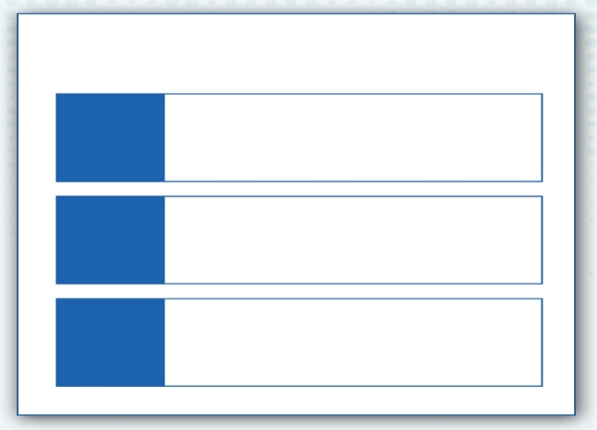
The three C’s of internal analysis
Quality of Staff – good or bad, highly trained
Financial situation – profitability – are sales up or down
Production capabilities – creating of new and improved products, production equipment, software used to produce
What do customers say about your business, your products, and service
Is your customer base growing or declining
What, when, and how do customer’s buy products
What is your competitive advantage over competitors?
Are Competitors taking market share
C
ompany
C
ustomers
C
ompetition

Slide 13
SWOT
Everyone take 4 yellow sticky notes
Do not enter your name on them (anonymous)
Think about yourself – what are 2 things that could be an opportunity for you in the future
Think about yourself – what are 2 things outside yourself that are a threat to you, your future, or your health
On the wall chart – place your sticky notes under the O & T

Slide 14
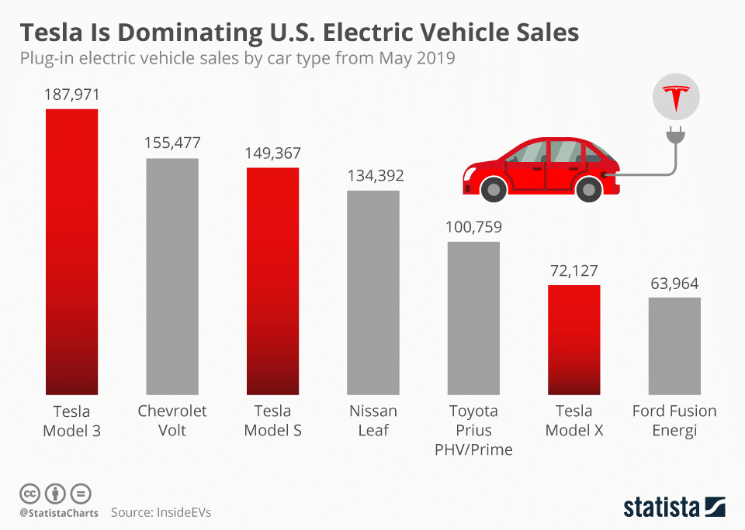
TESLA
Strengths:
Best in- Class Electric Cars
Highest Electric Vehicle Sales in Market
The Leading Auto Company – Even over BMW & Mercedes
Highly Innovative
Top Employer Company

Slide 15
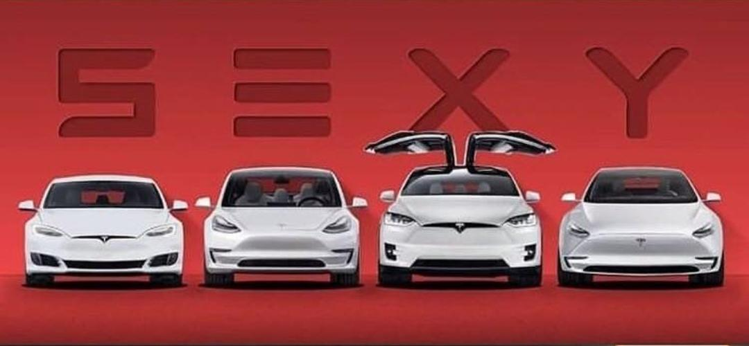
TESLA
Weaknesses:
Manufacturing Complications
Unable to meet demand might affect brand value
Lack of High Volume Production
Shortage of Batteries

Slide 16
Assignment:
Go to Google and Complete the SW of a Company Assignment in google.

Slide 17

External Factor
What two components of the SWOT analyze external factors that impact a business?
Opportunities & Threats
Marketing Essentials Chapter 2, Section 2.1

Slide 18
External Opportunities
Businesses must always look for opportunities to create competitive advantage and avoid threats (do better than competition)
This is done through:
Knowledge of the Trends
Environmental Scan
Marketing Essentials Chapter 2, Section 2.1

Slide 19
External Opportunities
1. Opportunities can include
Through following trends and customer attitudes we learn of opportunities for :
new and emerging markets
new business and product developments
strategic business partnerships that may create more sales and profits (TACO Bell)
Marketing Essentials Chapter 2, Section 2.1

Slide 20


2. Threats
environmental scan
An analysis of outside influences that may have an impact on an organization.
Businesses conduct an environmental scan X – analysis of outside influences that impact the organization
The acronym PEST refers to each of the four main areas evaluated in the external scan:
Political
Four Factors of a PEST Analysis
Economic
Socio-Cultural
Technological
Marketing Essentials Chapter 2, Section 2.1

Slide 21
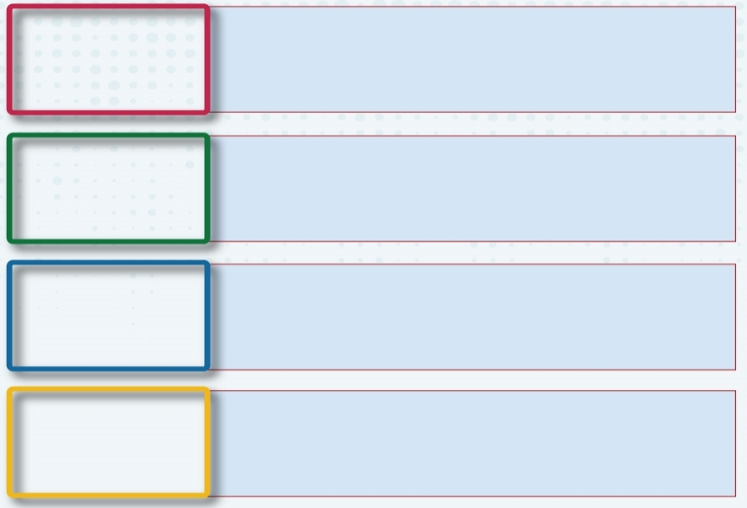
PEST Analysis
Government affects business operations
Changes in Laws that affect business
Changes in Regulations
Political Issues
Recession
Unemployment Rate
Currency Rates
Import Pricing
Trade Restrictions
Economic Issues
Socio-Cultural Factors
Changes in attitudes, lifestyles, and opinions provide opportunities and threats
Technology
Embrace technology and innovate to stay competitive – broadband, licensing such as patents, new technology, IT usage

Slide 22
What are current Issues?
Government affects business operations
Paid leave (4 weeks for illness, baby, care)
Eliminate Gas and Oil
Covid Regulations, Marijuana legalization
Political Issues
Unemployment
Business closures
Increased Minimum wages across states
Increased pricing, Supply Chain Issues
Economic Issues
Great Resignation
Racial Issues
Health and Safety issues at work Employee Satisfaction at work/ Work from home
Socio-Cultural Factors
Technology
Adapting to Technology – Everyone wants & uses it
Big Tech Companies
Example: Electric Cars and charging stations
Shipping needs to change (Amazon)

Slide 23
TESLA
Opportunities:
Sales expansion in untapped Market – China biggest opportunity
Less Expensive Car
Bringing battery production technology in-house
Introduction of pick-up truck

Slide 24
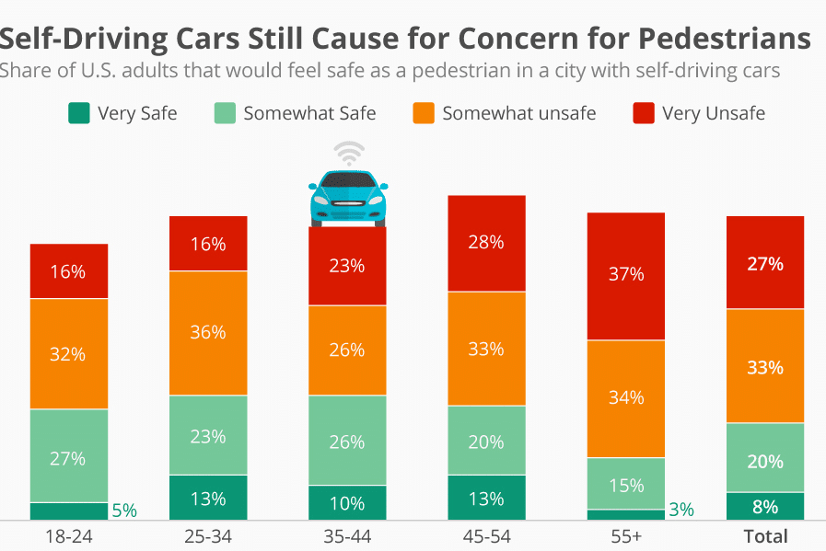
TESLA Threats
Product Liability Claims
Self-Driving Cars Are a Concern for Pedestrians
Dependent on Consumer Acceptance of Electric Vehicles
Extensive Competition (at lower prices)
Product Defects
Lack of Regulations for Self Driving

Slide 25
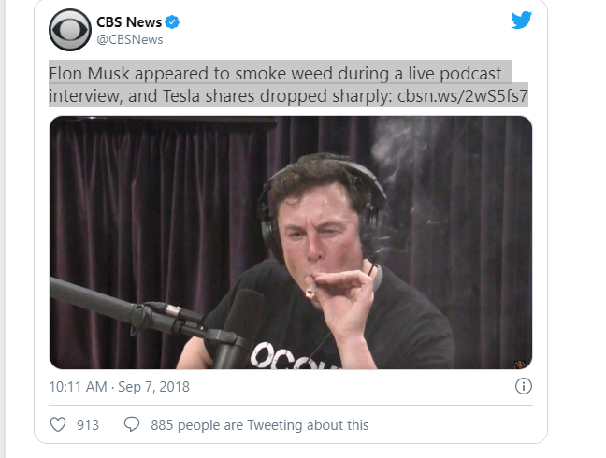
Impact of Bad Press:

Slide 26
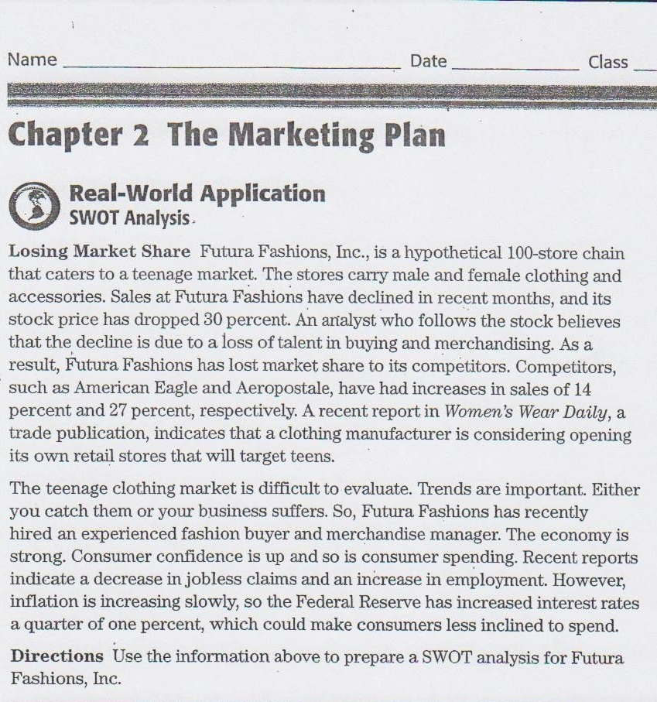
Strengths
Weaknesses
Opportunities
Threats

Slide 27
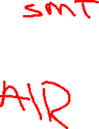
Six Elements of a Marketing Plan
Executive Summary
Situation Analysis
Your SWOT
Elements of a Marketing Plan
Single goal of what to do as a company (based on swot)
Objectives
Marketing Strategies
Implementation
Evaluation and Control

Slide 28
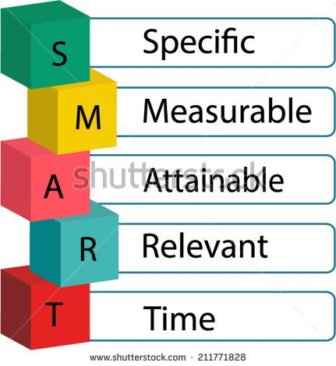
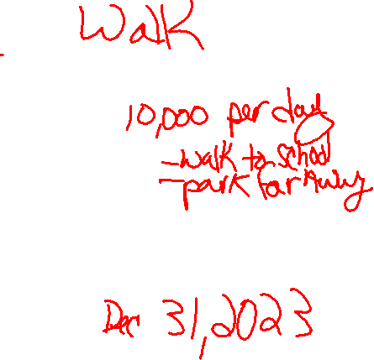
Increasing Sales using a SMART Goal?
Specific - Single focus
Measurable – something to show you succeeded
Achievable – What things you do to get there
Realistic – are you able to get there enough finances, resources, time
Timely - By what time frame

Slide 29
You conduct a SWOT of a business you learned a weakness you have is your sales are declining. While you carry a lot of different items, you notice your sweatshirt sales in the store are low. You decide to create a marketing plan around increasing your sweatshirt sales.
Let’s make this into a Smart Goal

Slide 30
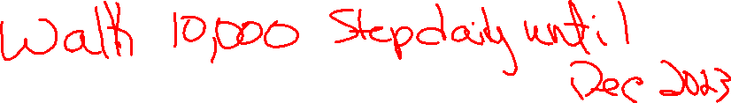
Use a SMART Goal? weakness sales are declining on sweatshirts
Increase the sale of Sweatshirts
By 10%
By increasing product options, marketing on social media, and having sales events
To do so, I will need about four months to purchase and market
By August 1, 2022

Slide 31
SMART Goal = Increase sales on Sweatshirts by 10% by February 1, 2018
Increase the sale of Sweatshirts
By 10%
By increasing product options, marketing on social media, and having sales events
To do so, I will need about three months to purchase and market
By August, 2022

Slide 32
Goal: Your have $4800 credit card debt that needs to be paid off.
Specific: I will pay off $4,800 on my credit card
Measurable: by paying $200 each month
Achievable: cut back unnecessary purchases, lower my monthly discretionary spending, don’t purchase items if I don’t have the money. Leave card at home
Relevant/Realistic: Will pay this off in 24 months, still have some fun money, and still save.
Timely: By November 2021.

Slide 33
Assignment Write SMART Goals You want to get fit and be healthy. Write a specific, measurable goal to do that. Mrs. Vetter will check your notes on Monday.
S
M
A
R
T

Slide 34
Writing a Marketing Plan
marketing plan X A formal written document communicating the goals, objectives, and strategies of a company’s activities for a specific time
- written after conducting a SWOT Analysis
Purpose: A Roadmap of how a product will enter the market, be advertised and sold
It communicates to management:
Company goals, objectives and strategies
Specific responsibilities
Budgets
Deadlines for completion
Overall performance

Slide 35
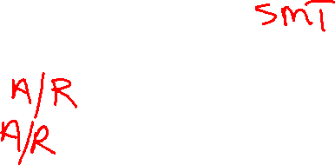
Six Elements of a Marketing Plan
Executive Summary
Written last – defines the entire plans key points
Situation Analysis
Your SWOT
Elements of a Marketing Plan
Single goal of what going to do as a company.
Objectives
Marketing Strategies
4ps: Product, Place, Price, Promotion
Implementation
When, how, and who will implement plan, budget
Evaluation and Control
Measurement on how you are doing

